Slide 1
Machine Learning Learnings
From perceptron to object detection

Slide 2
Table of Contents
Perceptron
Biological representation
Artificial representation
Feed-forward
Classification
Regression

Slide 3
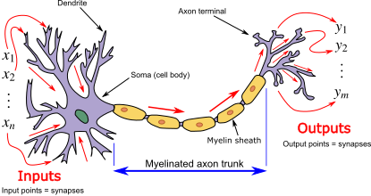
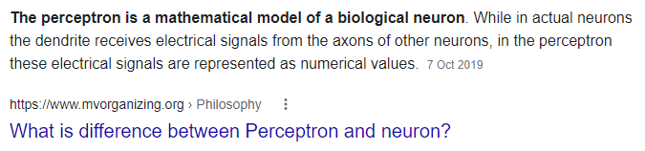
Perceptron? Neuron?
(Insert mandatory biological neuron explanation)

Slide 4
bias
(error function?)
classification
W0 + w1x1 + w2x2 = 0

Slide 5
Insert regression
bias

Slide 6
Initial weights (glorot initializer / etc)

Slide 7
Cost function / Gradient descent
Simple regression example using probably MSE?
Representation learning (?)
Dropout (?)
But real world is not that straightforward
Mention reguralizations/different cost functions

Slide 8
Introducing non-linearity
ReLU/Sigmoid/TanH/ etc…
bias
Classification vs regression…
Activation
function

Slide 9
Multilayer perceptron
Activation
function

Slide 10
(Deep) Neural Networks
https://stats.stackexchange.com/questions/315402/multi-layer-perceptron-vs-deep-neural-network

Slide 11
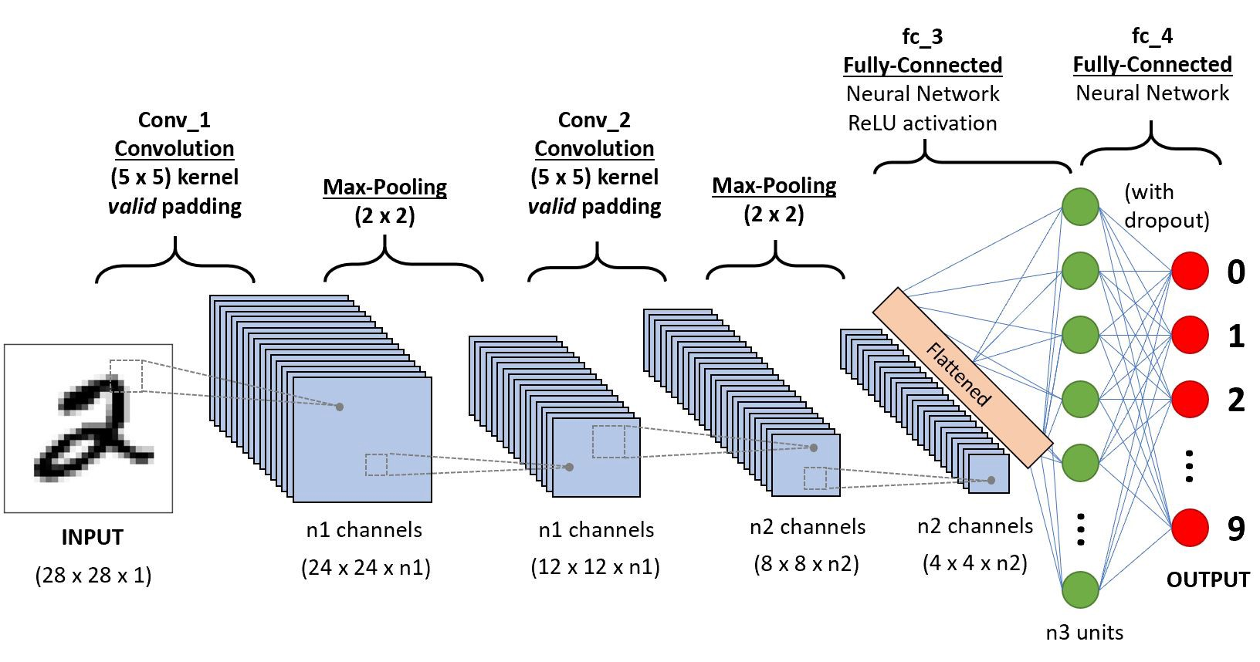
Convolutional Neural Network
Source: https://towardsdatascience.com/a-comprehensive-guide-to-convolutional-neural-networks-the-eli5-way-3bd2b1164a53

Slide 12
Insert img of img classification without cnn

